Slide 1
Course Introduction
Welcome to ENGL 3110

Slide 2
Return Exams
Grade Breakdown
A | 110/100 - Perfect | 2 students
A | 106 to 100 | 7 students
A | 99 to 90 | 5 students
B | 89 to 80 | 3 students
C | 79 to 79 | 1 student
F | 59 to 00 | 1 student

Slide 3
Homework Re-View
Good Steps to ID Sentence Patterns
  Identify the Subject Headword and Predicate Headword
  Identify all the Phrases
  Work through the patterns in this order
    Is it a Copular Be? – has a “be” verb and 1 complement
    Is it a Linking Verb? – can replace main verb with “be” and 1 complement
    Is it Intransitive? – has no objects or complements
    Is it Transitive? – has ONE object
    Is it Ditransitive? – has TWO objects or 1 object and 1 complement

Slide 4
Sentence Patterns Handout
Extremely Important for Unit Two
Will Feel Better with Practice
Today
  Copular “Be” - subject complement
  Linking Verbs – subject complement
  Intransitive
  Transitive – direct object
Wednesday
  Ditransitive
  Optional Adverbials (separate handout)

Slide 5
Sentence Patterns Handout
Quick Note on Terminology: “Transitive”
Many linguists will only identify three types of sentences
  Intransitive
  Transitive
  Ditransitive
They consider “copular be” and “linking verbs” as KINDS of Transitive sentences
For us, “Transitive” will always mean “has a direct object”

Slide 6
Intransitive Sentence
Everything we have diagrammed so far is Intransitive
No Complements, Direct Objects, or Indirect Objects
Still Infinitely Generative and can be long!
  Can add adjectivals and determiners to the noun phrase
  Can add adverbials, modals, and aux verbs to the verb phrase
  Can add adverbials to modify the sentence

Slide 7
Copular “Be”
All forms of BE (is, are, was, were, be, being, been)
  We will see new stuff in Unit Three
  In Unit Two anything with these words is Copular
“Copular” is the broader term for all languages
  “Be” is the English copular
Has a “Subject Complement”
  The book calls some of these “Adverbials” but we will call them all just “Subject Complements”

Slide 8
Copular “Be”
All forms of BE (am, is, are, was, were, be, being, been)
  We will see new stuff in Unit Three
  In Unit Two anything with these words is Copular
“Copular” is the broader term for all languages
  “Be” is the English copular
Has a “Subject Complement”
  The book calls some of these “Adverbials” but we will call them all just “Subject Complements”

Slide 9
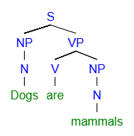
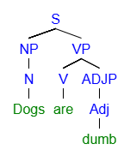
Copular “Be” Sentence

Slide 10
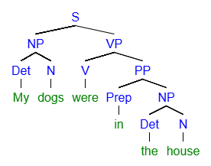
Copular “Be” Sentence
Textbook will call “in the house” and “Adverbial”
We will just call it a Subject Complement

Slide 11
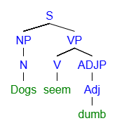
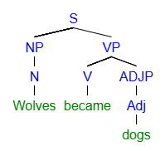
Linking Verb Sentence

Slide 12
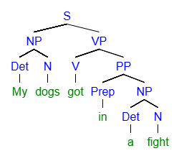
Linking Verb Sentence
Textbook doesn’t even cover these [PPs with linking verbs]
We will just call this a Subject Complement too.

Slide 13
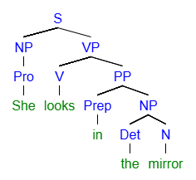
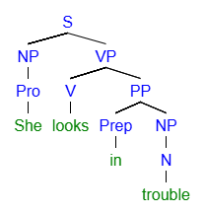
Linking Verb Sentence
You have to rely on meaning sometimes
    Intransitive Linking Verb

Slide 14
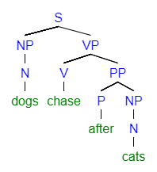
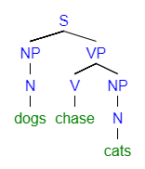
Intransitive Sentence
If it has a “Loose” NP after the verb, its Transitive or Ditransitive
  By “Loose” I mean – not inside a PP
  Intransitive Transitive

Slide 15
Homework Review
  Remind me to take Questions after we look at the Answers!

Slide 16
Pattern ID Practice
  The next slides contain four sentences each.
  All four sentences are the SAME pattern.
  Guess which pattern each slide is & try to ID the parts.

Slide 17
Pattern ID Practice
  The big bird on my roof screams every day
  That classless fool never pays on time.
  The AC adaptor does not fit in this port.
  Steve sleeps well in his big waterbed.

Slide 18
Pattern ID Practice
  Todd and his mother are not on speaking terms right now.
  No, it wasn’t.
  I have been in a rush all semester.
  Our test is very soon.

Slide 19
Pattern ID Practice
  Tom’s new roommate seems sketchy.
  It doesn’t appear so.
  That clue smells fishy to me.
  I looked like a fool last night.

Slide 20
Pattern ID Practice
  I was not bald last month!
  Dogs are the best pets.
  Cats have been human companions for millennia.
  I’m happy for you.

Slide 21
Pattern ID Practice
  That guy over there ate all the food.
  It found me!
  Steve’s band played a killer set last night.
  Next Wednesday, we will all take a test in class.

Slide 22
Pattern ID Practice
  Dave gave Buster a big old smooch on the cheek.
  Steve’s band played Janet a love song.
  That gives me an idea.
  Next Wednesday, I will bring my grandmother a basket of fruit.

Slide 23
Pattern ID Practice
  The Queen anointed him Sir Dingle of Dangle.
  The law of the land deems that a serious crime.
  I considered Jim’s text too thirsty by far.
  Steve named his band “Rage Against the Caffeine.”

Slide 24
End of Class
If you have questions or concerns, hang around to talk.

